Slide 1
India Innovation 2.0

Slide 2
Agenda
Date – 15-May-2018
Why I am doing this ?
What is happening in India Innovation?
Identity
Payment
Data
What's your take away?

Slide 3
Key Events
1982
January 1, 1983
May 1, 2000

Slide 4
Why I am doing this ?
Uber – Early 2015. Bank ? Utility Payment ? Bus/ Movie Ticket?

Slide 5
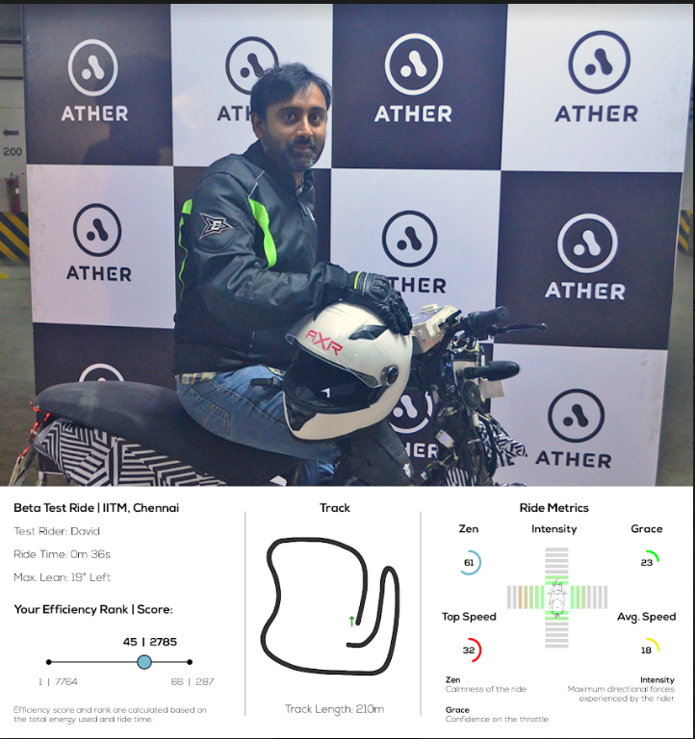
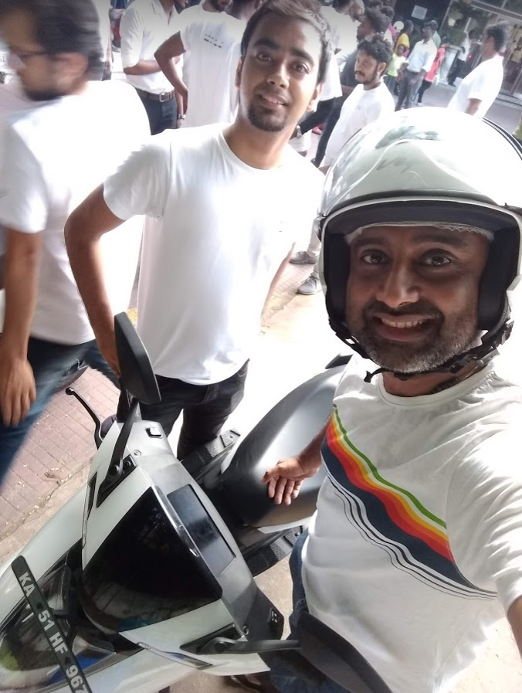
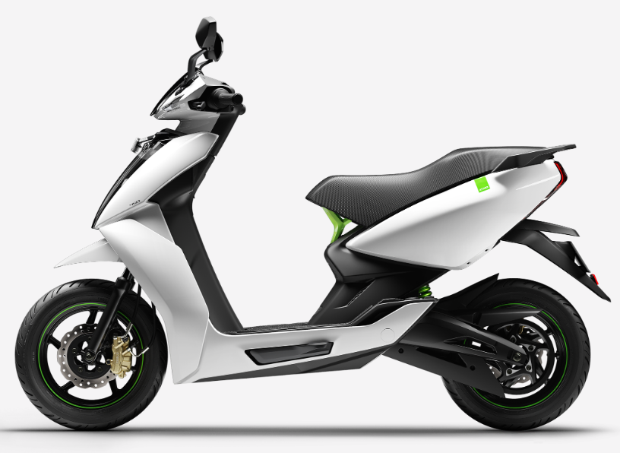
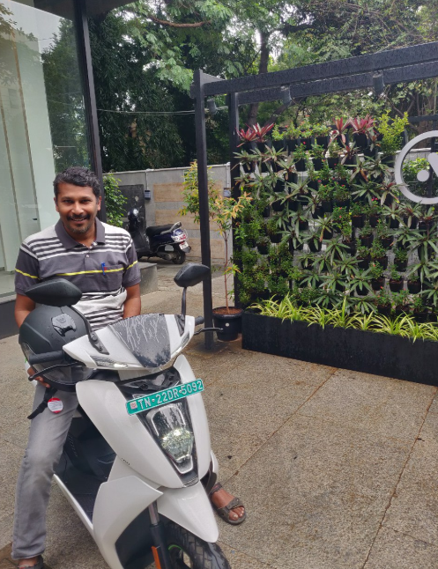
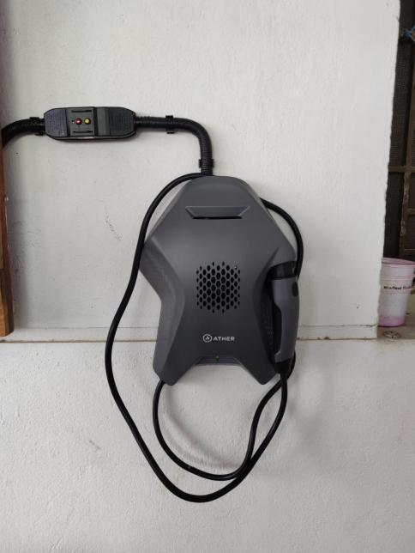
Why I am doing this ?
Ather Energy

Slide 6
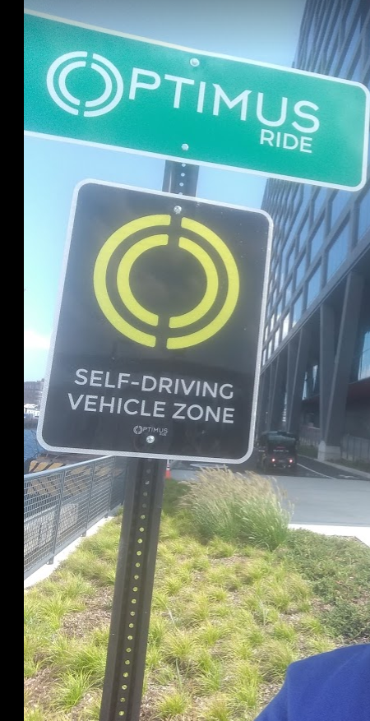
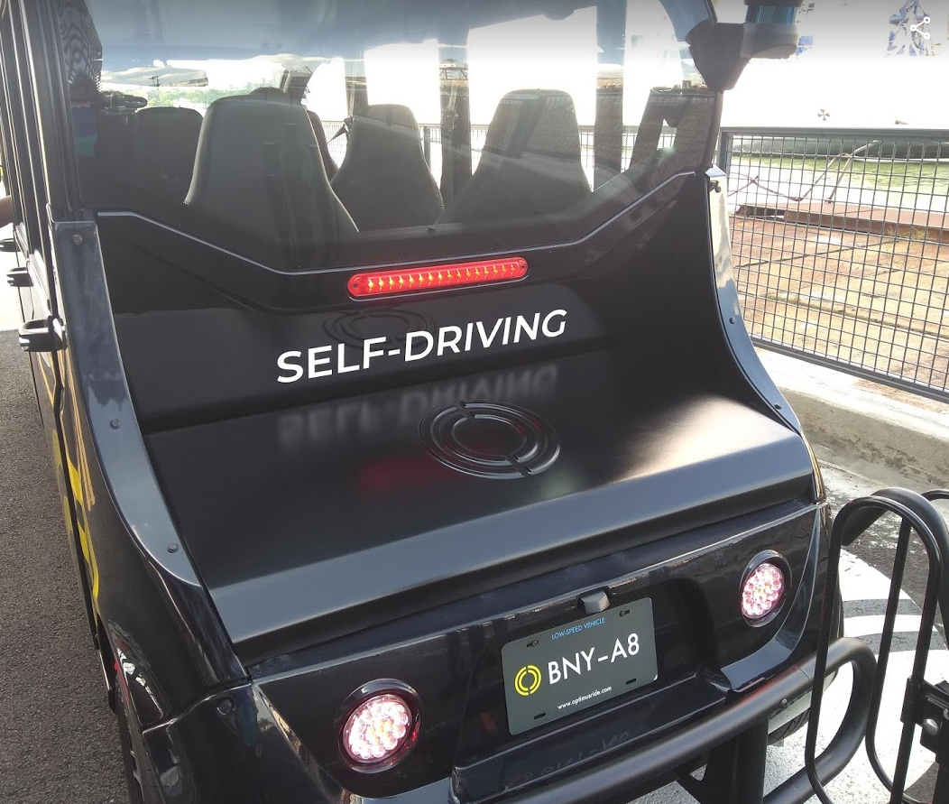
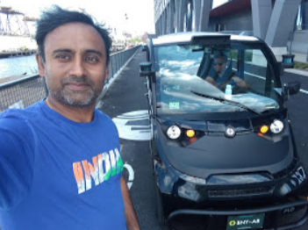
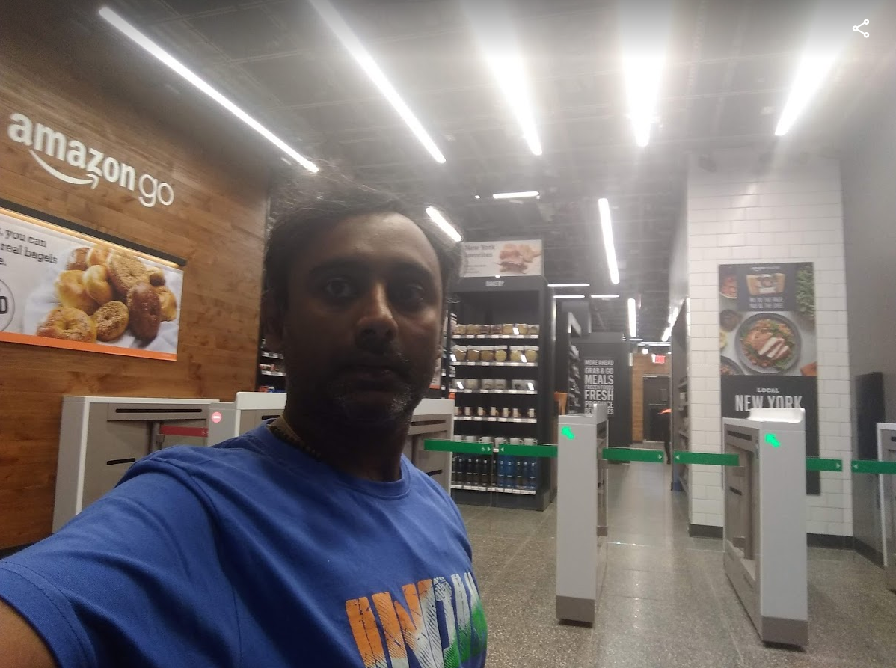

Why I am doing this ?

Slide 7
How many of you think our tech is not
world class??

Slide 8
Identity Layer

Slide 9
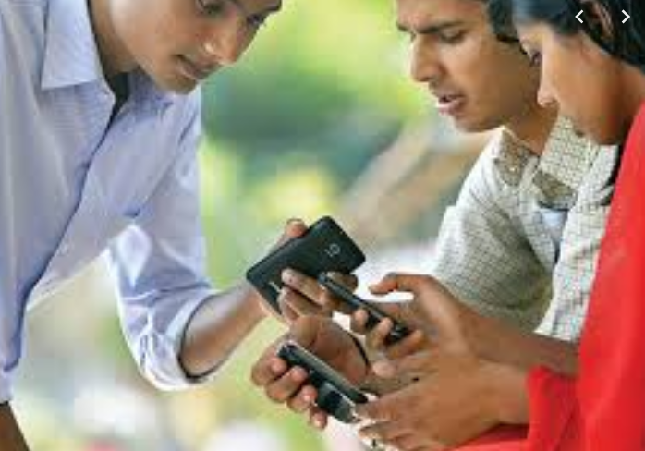
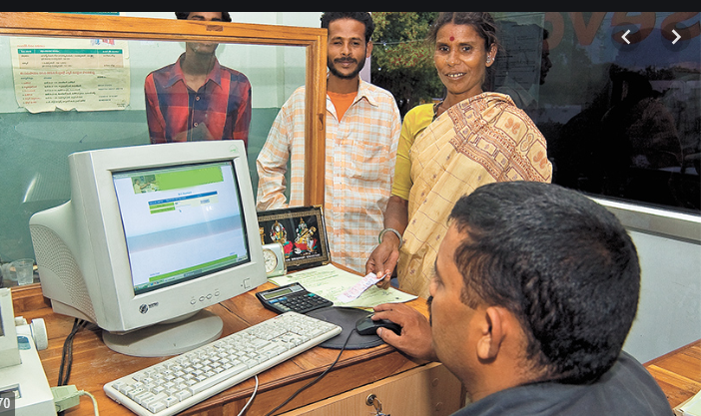

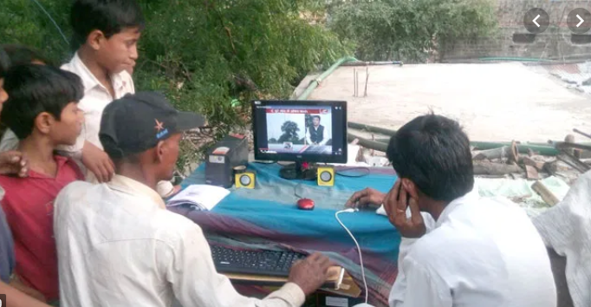
The other India - Bharath

Slide 10





Story Starts….. 2009

Slide 11

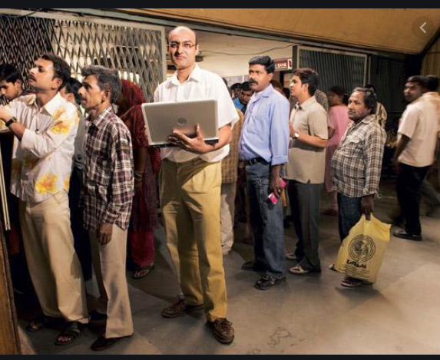
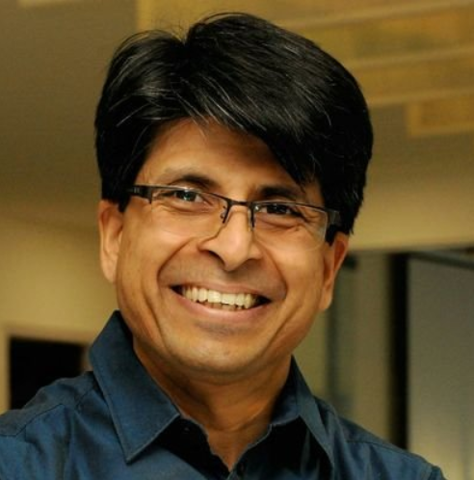
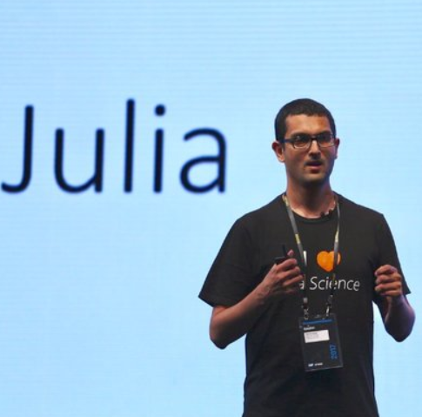
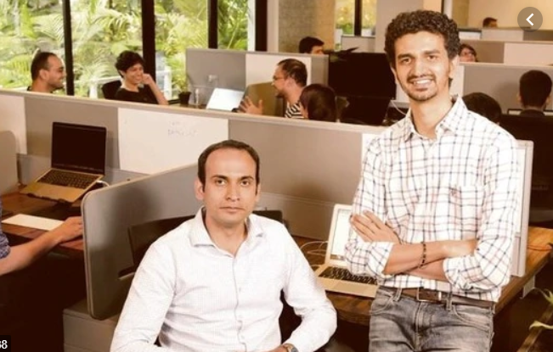
Rock Stars
https://blogs.wsj.com/indiarealtime/2010/09/29/whos-who-in-nilekanis-uid-dream-team/

Slide 12
Problem Statement
What's the scale of the problem?????

Slide 13
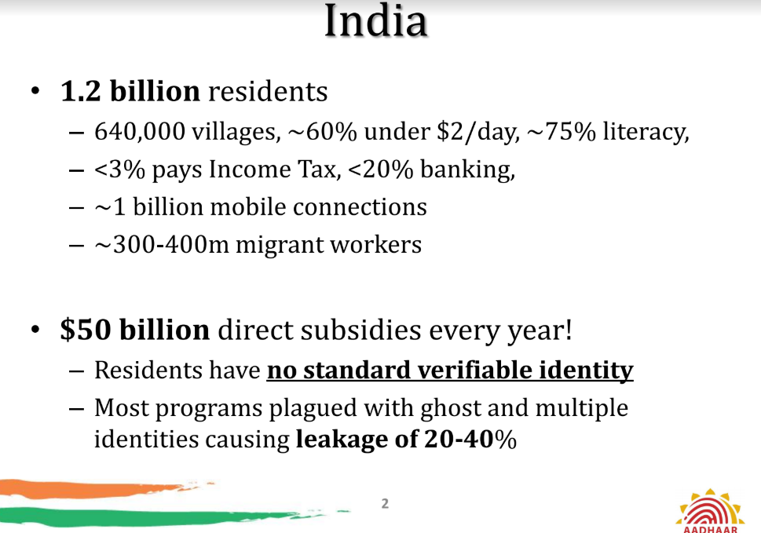
Problem Statement

Slide 14
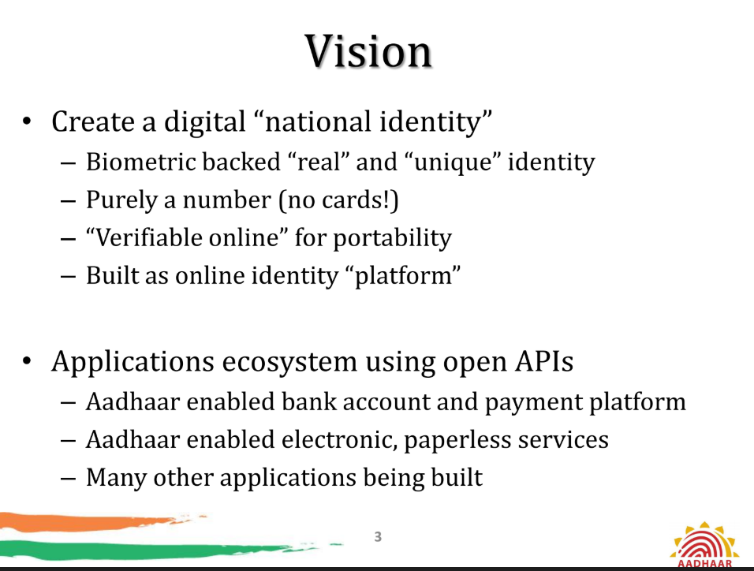
Vision

Slide 15
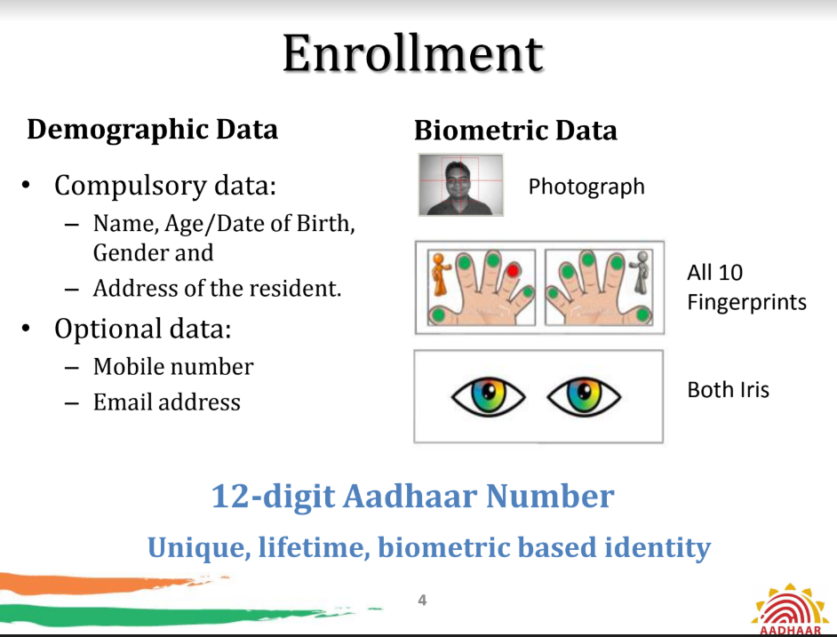
Process

Slide 16
Process

Slide 17
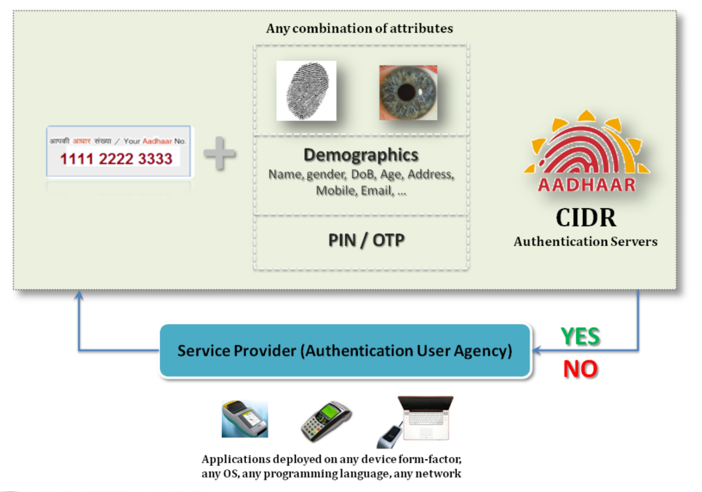
Process

Slide 18
Process

Slide 19
Process

Slide 20
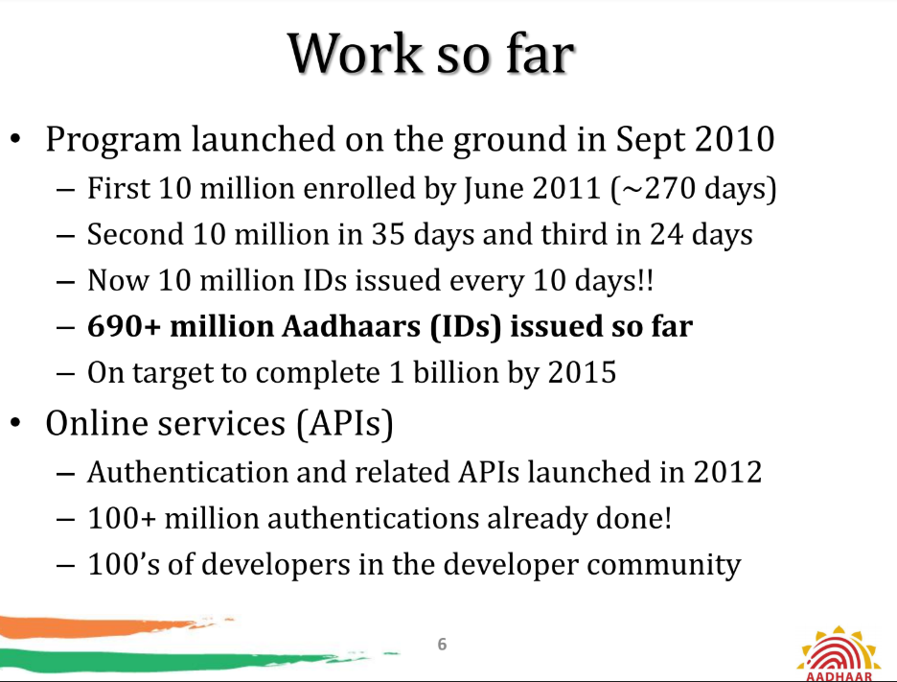
Process

Slide 21
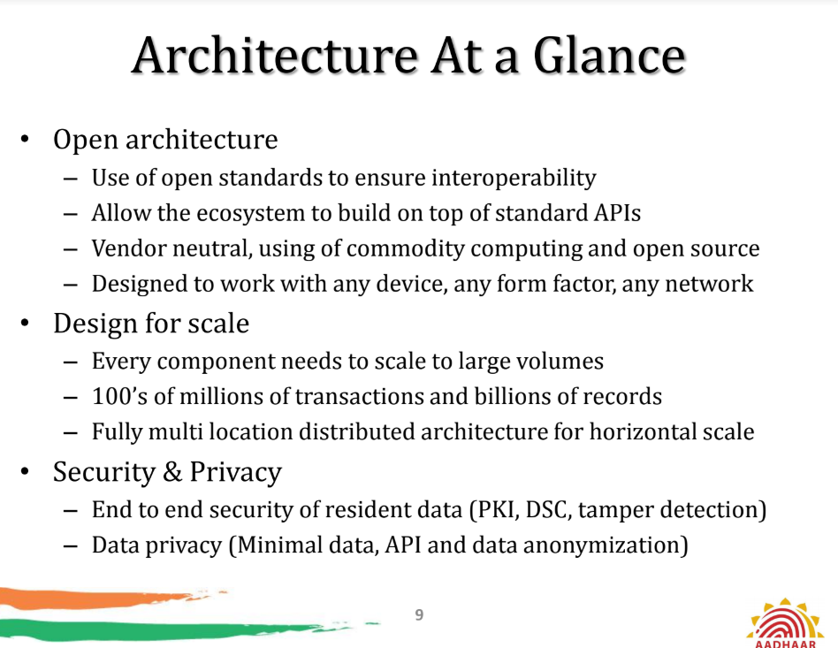
Arch

Slide 22
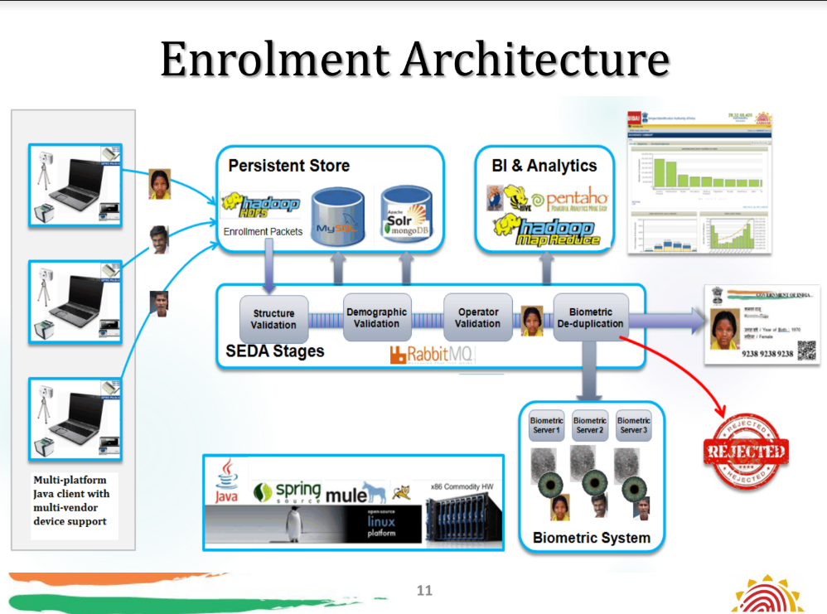
Arch

Slide 23
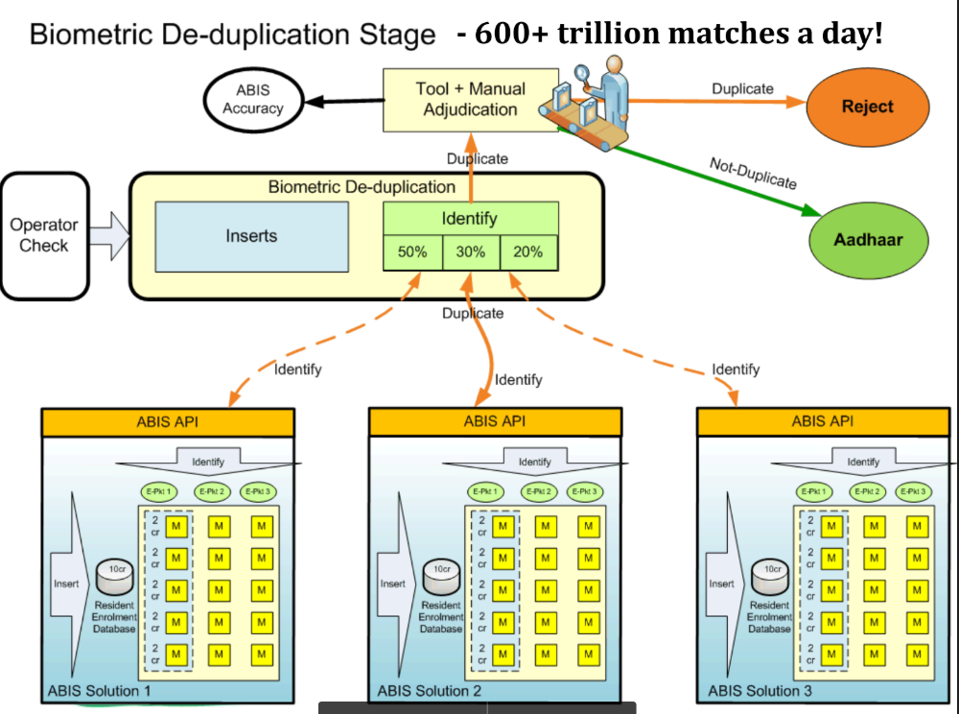
Arch

Slide 24
Arch

Slide 25
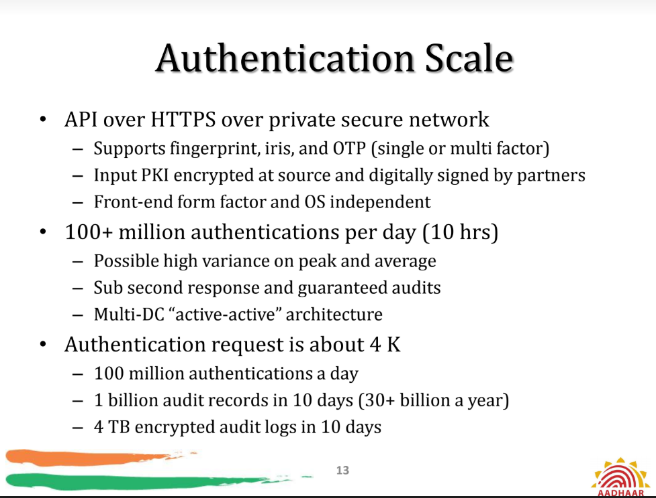
Arch

Slide 26
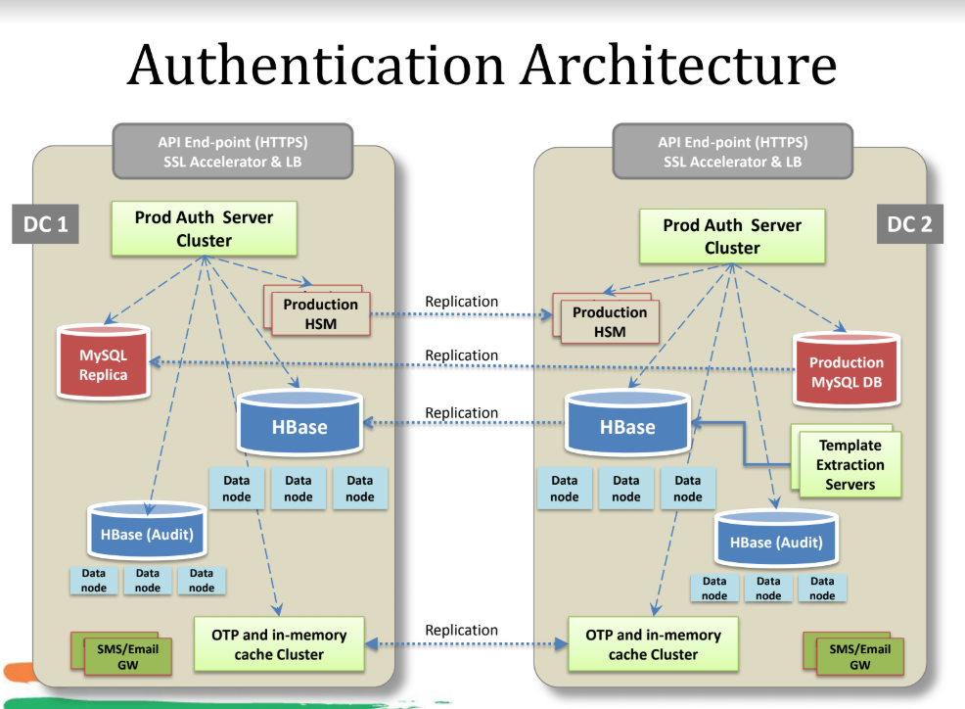
Arch

Slide 27
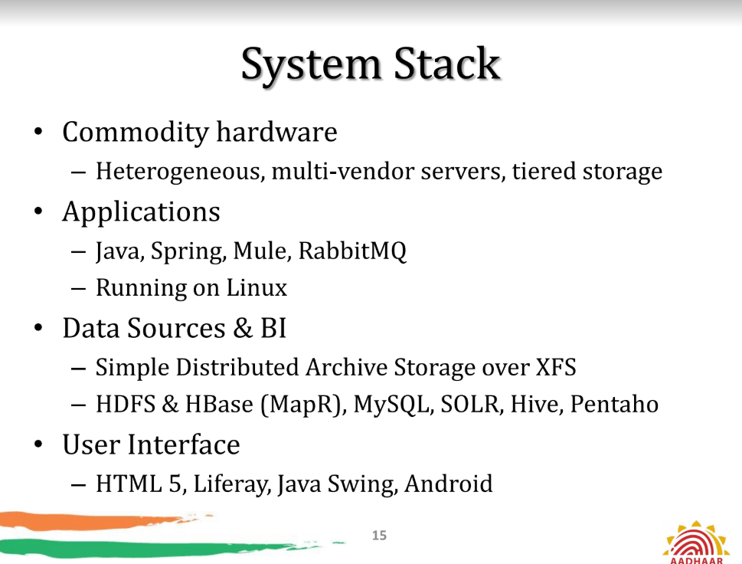
Arch

Slide 28
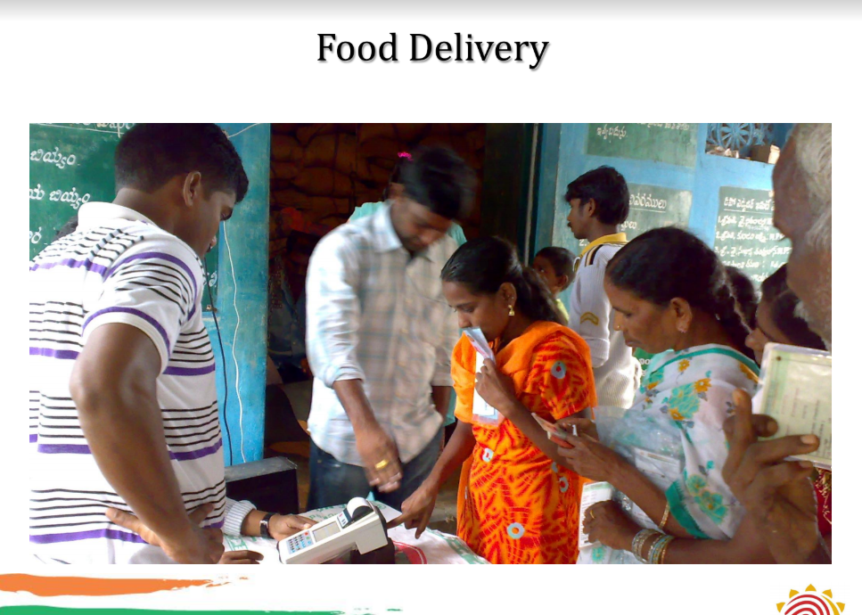
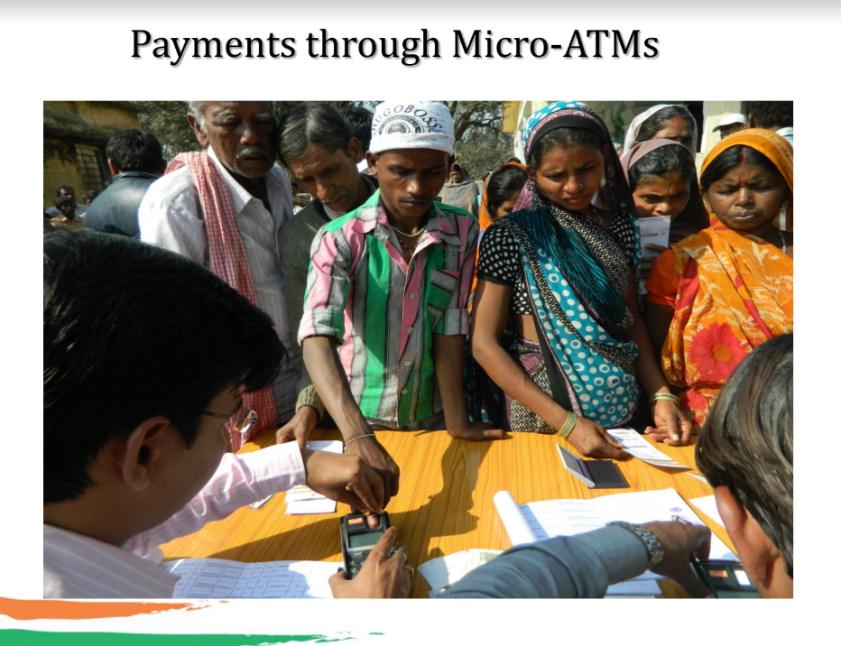
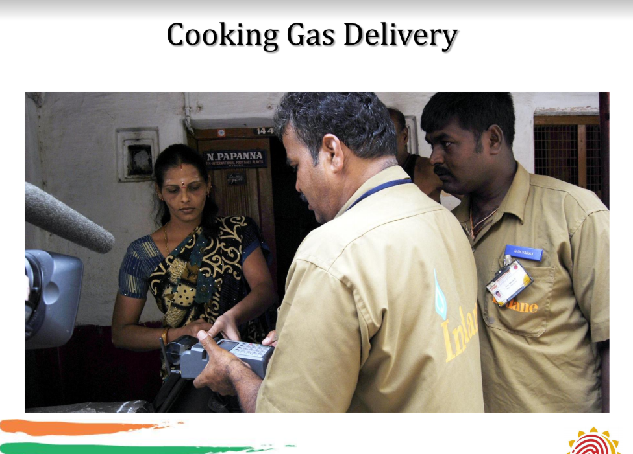
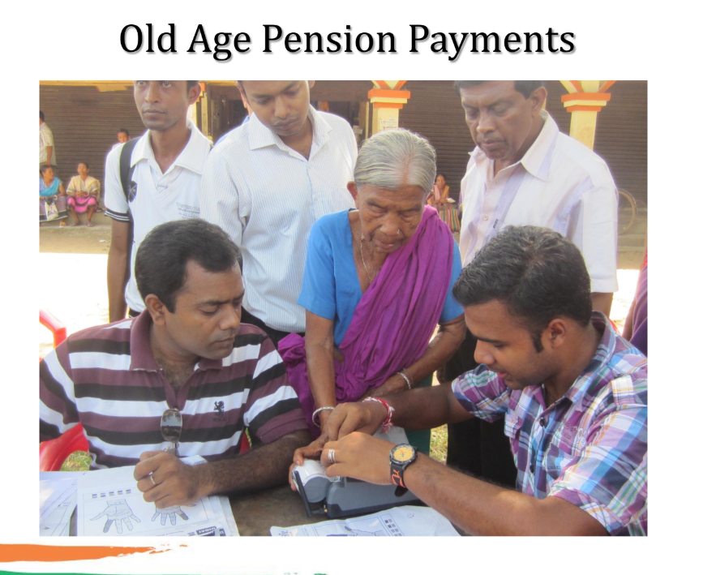
Use Cases

Slide 29
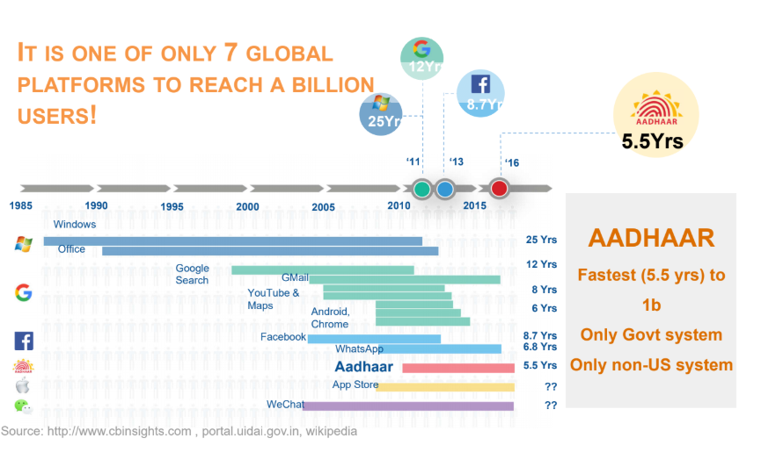
Scale

Slide 30
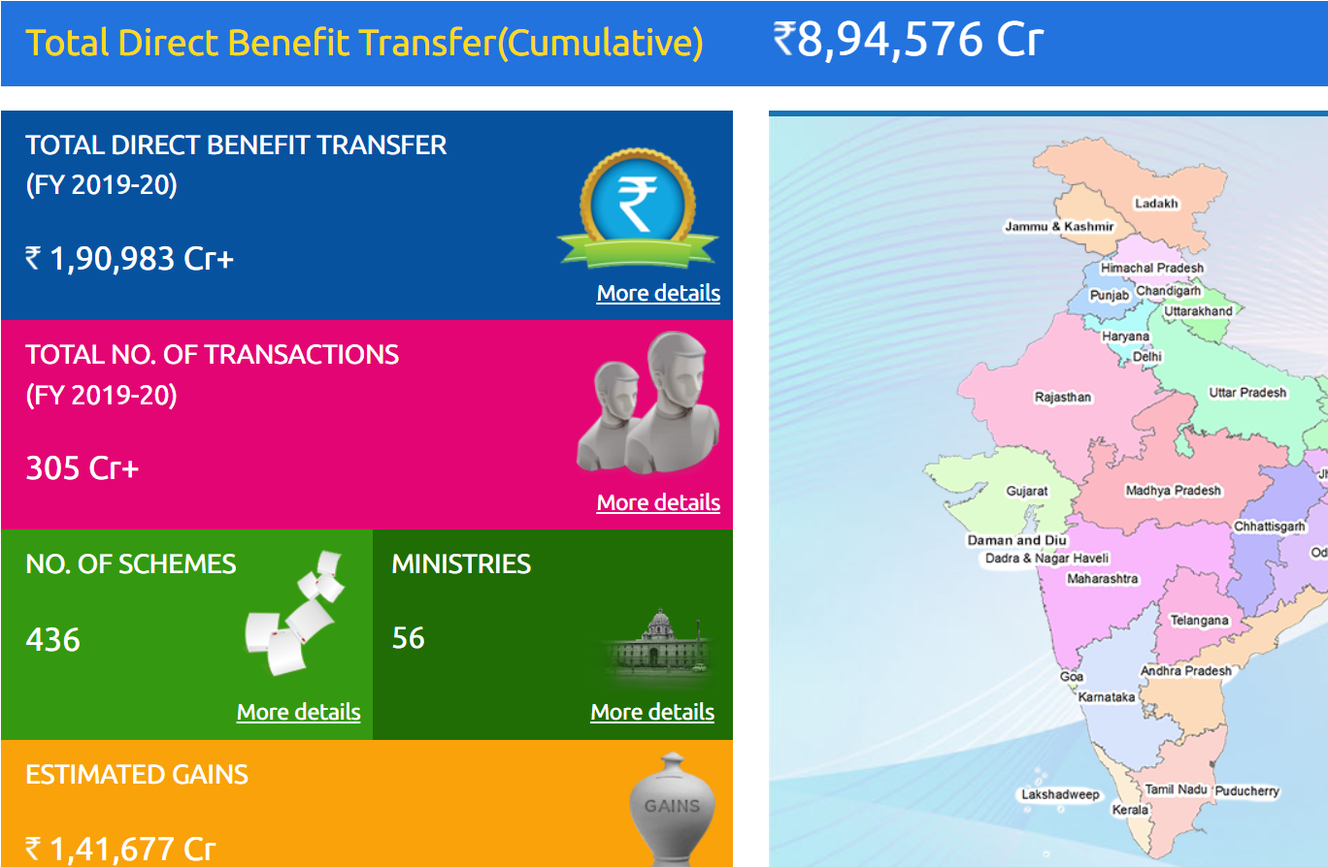
Use Cases

Slide 31
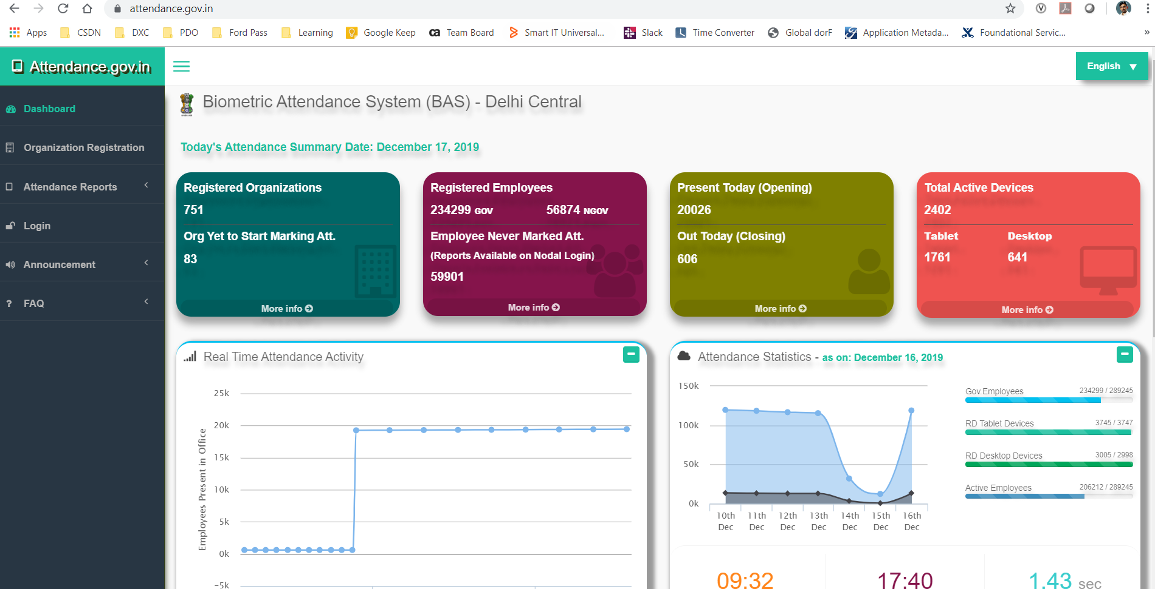
Attendance

Slide 32
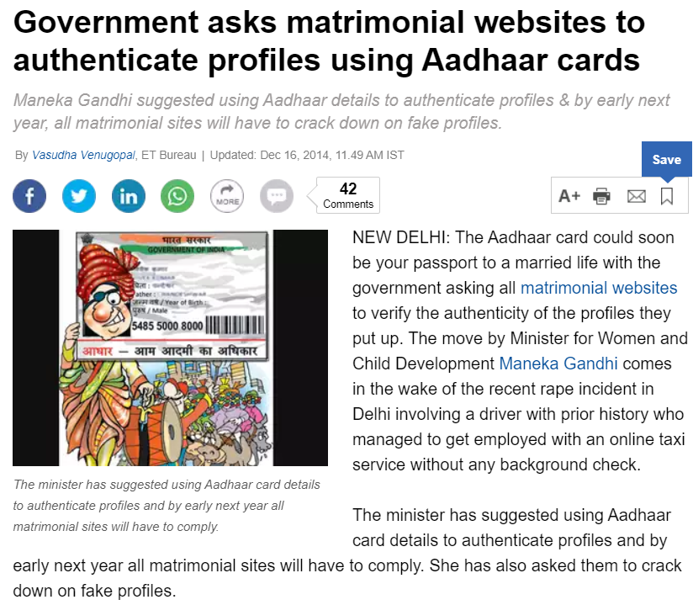
Use Cases

Slide 33
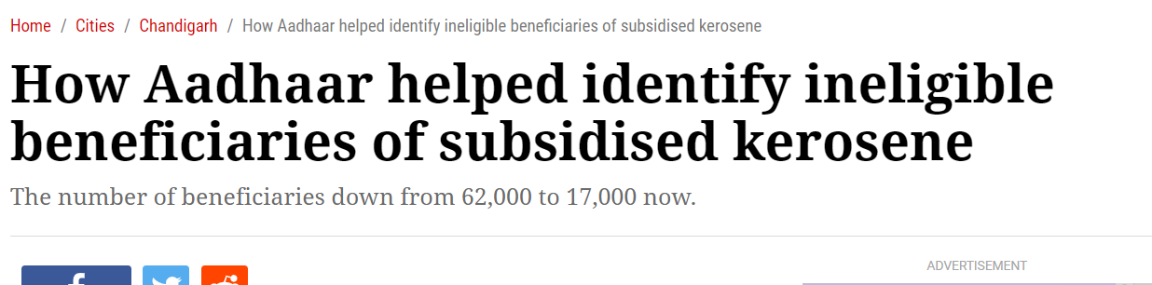
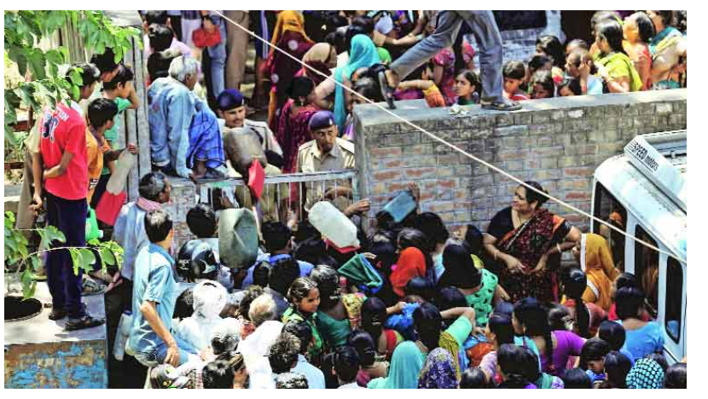
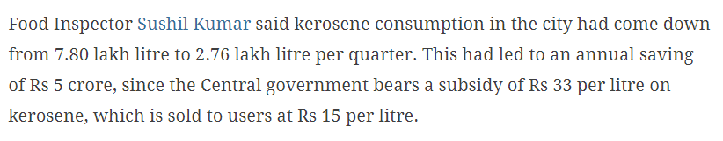
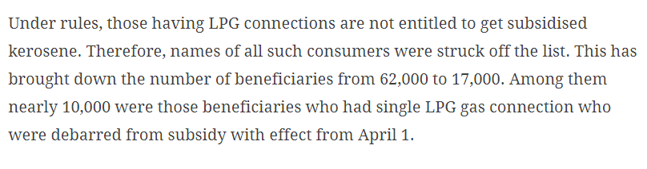
Use Cases

Slide 34
Payment Layer

Slide 35
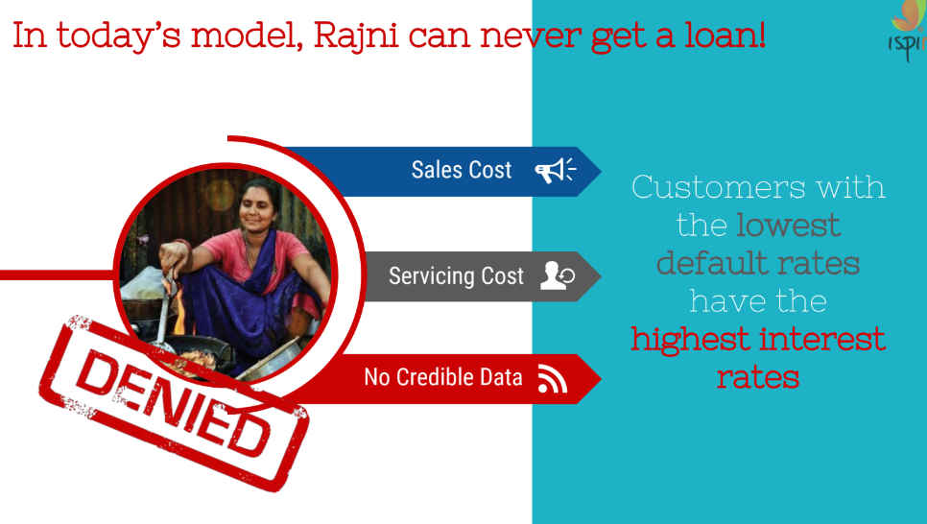
Payment Issue

Slide 36
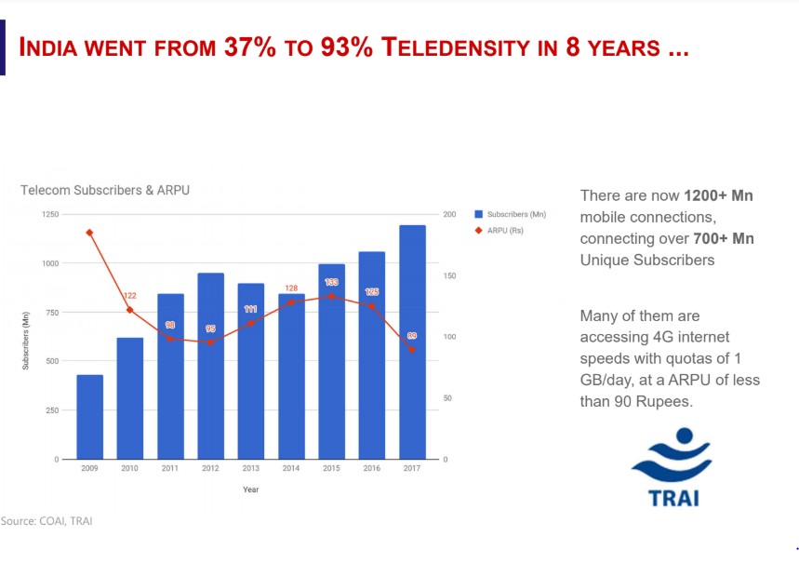
New India

Slide 37
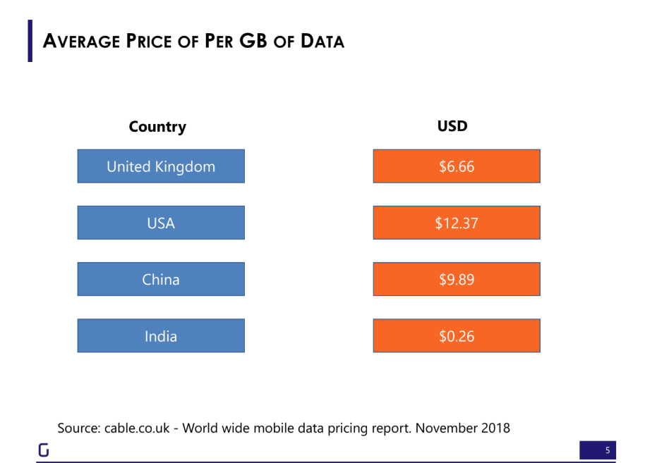
Data rates Crashed

Slide 38
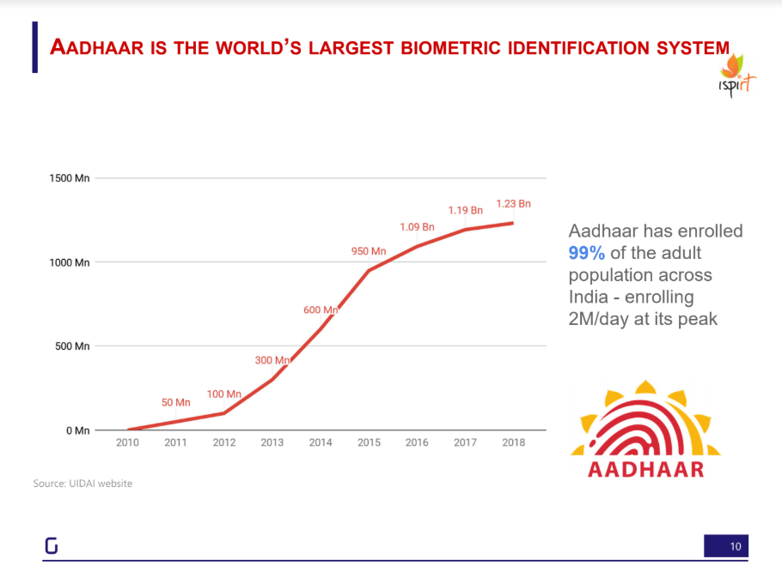
New India

Slide 39
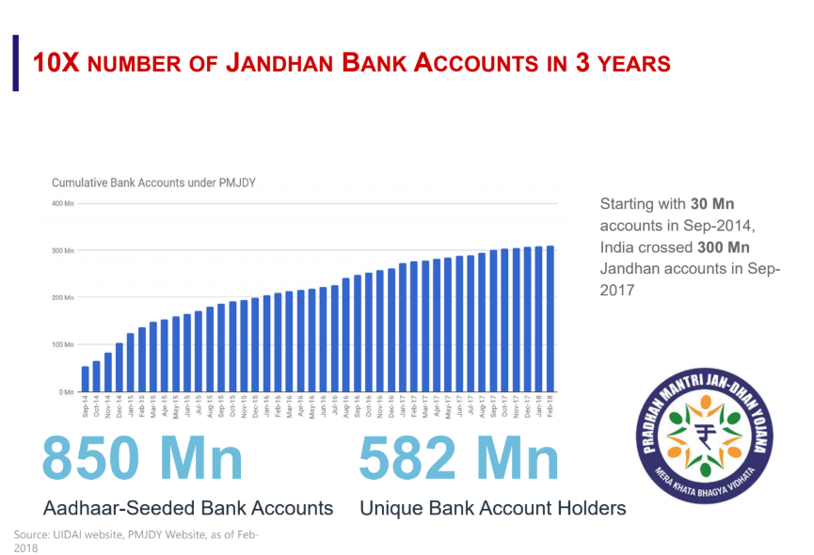
New India

Slide 40
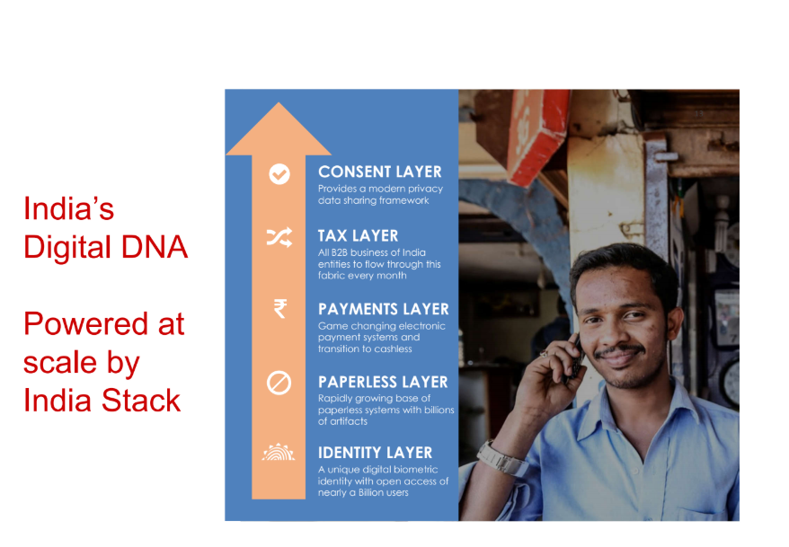
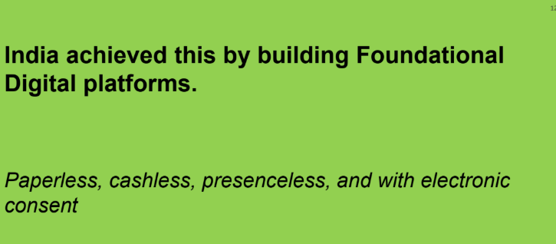
New India

Slide 41
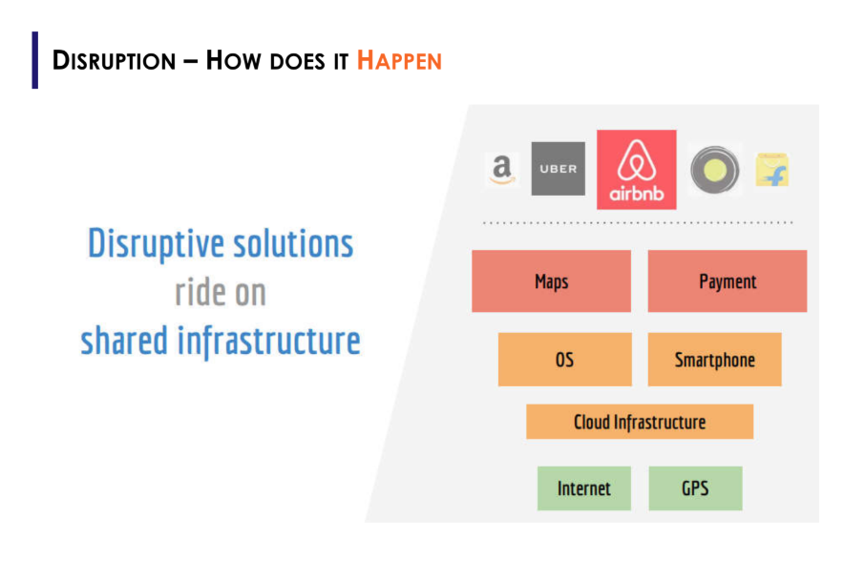
Disruption Model

Slide 42

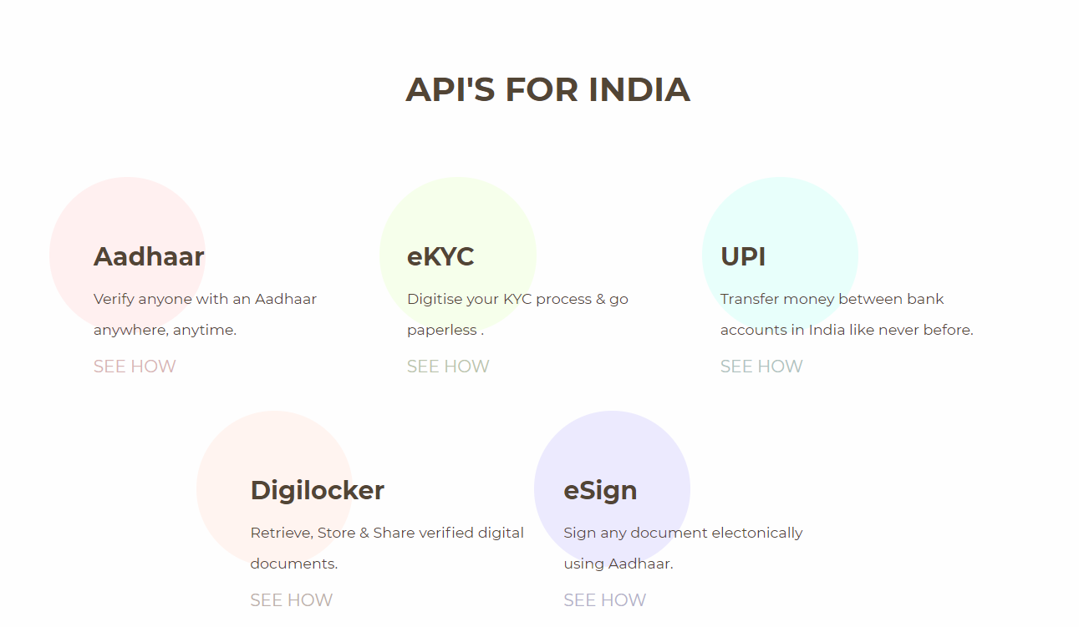
Powered by India Stack
https://indiastack.org/

Slide 43
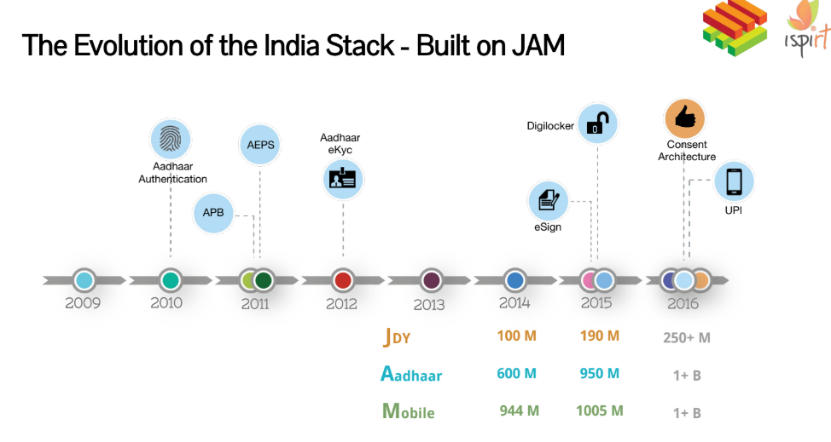
India Stack Evolution

Slide 44
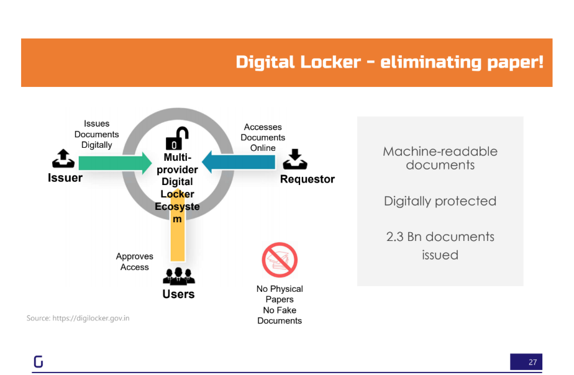

Digilocker
2004 later CBSE Marksheet in Digilocker

Slide 45

eSign

Slide 46


GSTn

Slide 47










NPCI – 2008 - Not-for-profit organisation

Slide 48

Take away No - 1
UPI ID of FASTag is NETC. Vehicle Registration Number@ Customer bank. For e.g. Vehicle Registration number is MH04BB1234 and issuer bank is ICICI Bank then UPI ID will be netc.
netc.tn01bb1234@icici

Slide 49

Pre-2016

Slide 50

Post-2016

Slide 51


Post-2016

Slide 52


Post-2016

Slide 53

UPI

Slide 54



UPI

Slide 55

UPI

Slide 56





Take away No – 2. Data is your money. Please lock it.

Slide 57
Data Layer

Slide 58

Data Layer

Slide 59

Data Layer

Slide 60

Data Layer

Slide 61

Data Layer

Slide 62

Data Layer

Slide 63


Data Layer

Slide 64

Data Layer

Slide 65
Payment Issue

Slide 66


Payment Solution
Do use FinTech Apps for lending?

Slide 67

Payment Solution

Slide 68

Payment Solution

Slide 69

Payment Solution

Slide 70

Payment Solution

Slide 71

Payment Solution

Slide 72
Its a Wrap

Slide 73

Wrap

Slide 74

Our Tech

Slide 75

Our Tech

Slide 76

Our Tech

Slide 77

Wrap

Slide 78

Wrap

Slide 79

Wrap

Slide 80

New India

Slide 81


New India

Slide 82




My Experience

Slide 83



India Digital Tech International Export

Slide 84
Thank you

